Slide 1
Source Inversion Validation (SIV):
Quantifying Uncertainties in
Earthquake Source Inversions
Martin Mai
Morgan Page
Danijel Schorlemmer

Slide 2
The new, re-created website
http://siv.usc.edu/Introduction

Slide 3
The new, re-created website
http://siv.usc.edu/Exercises

Slide 4
The new, re-created website
http://siv.usc.edu/Downloads

Slide 5
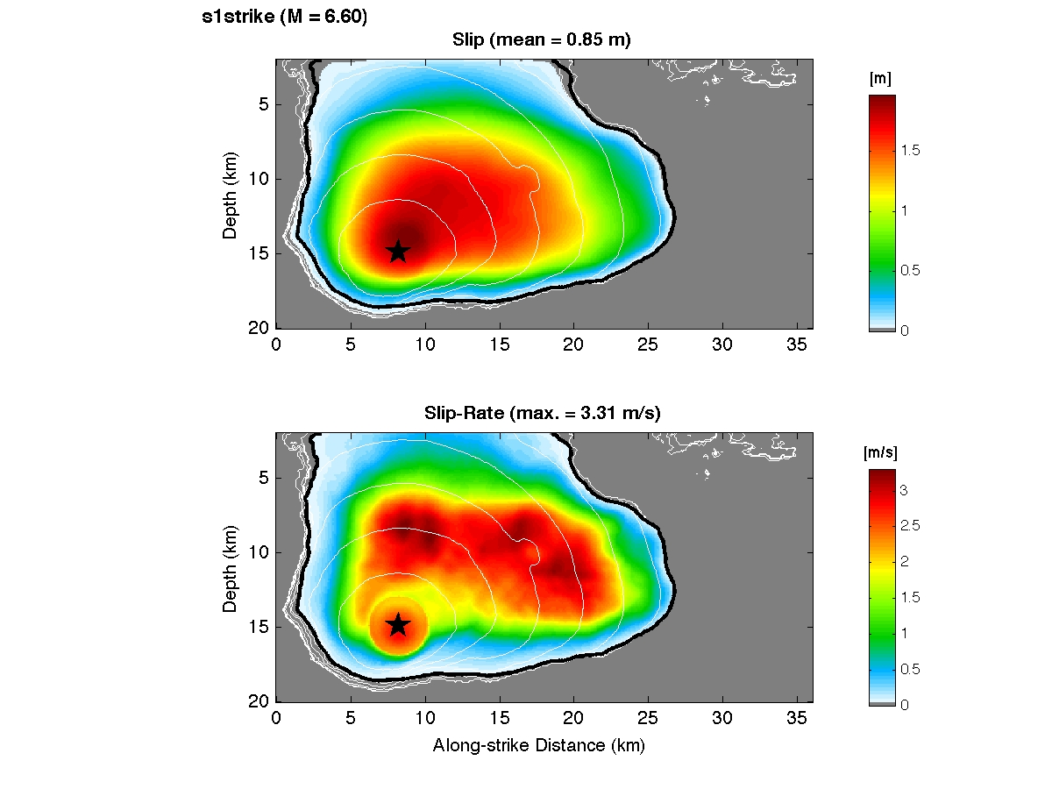
An initial inverse exercise, inv1
based on crack-like spontaneous dynamic rupture model, embedded in a layered isotropic velocity-density model (same as before)
vertical strike-slip fault, M ~6.6, no surface rupture
the model below is an example but not the ones used for the exercise ...

Slide 6
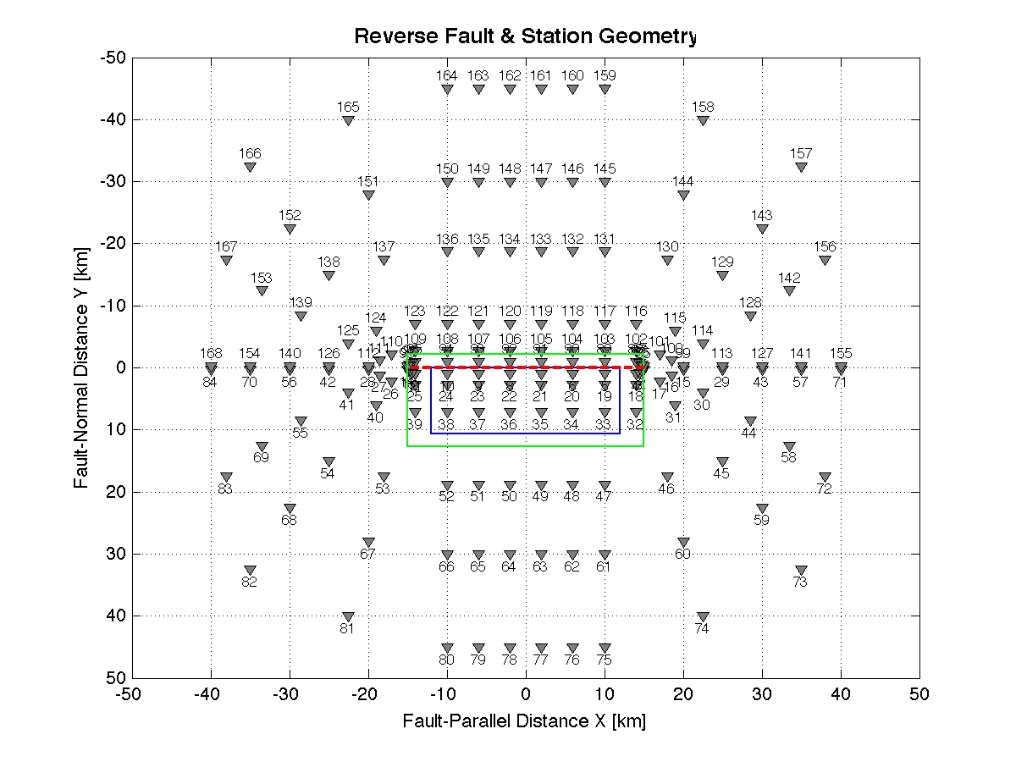
An initial inverse exercise, inv1
synthetics at 168 locations, but only a fraction to be used in the inversion; remaining receivers can be used to predict motions based on inferred rupture

Slide 7
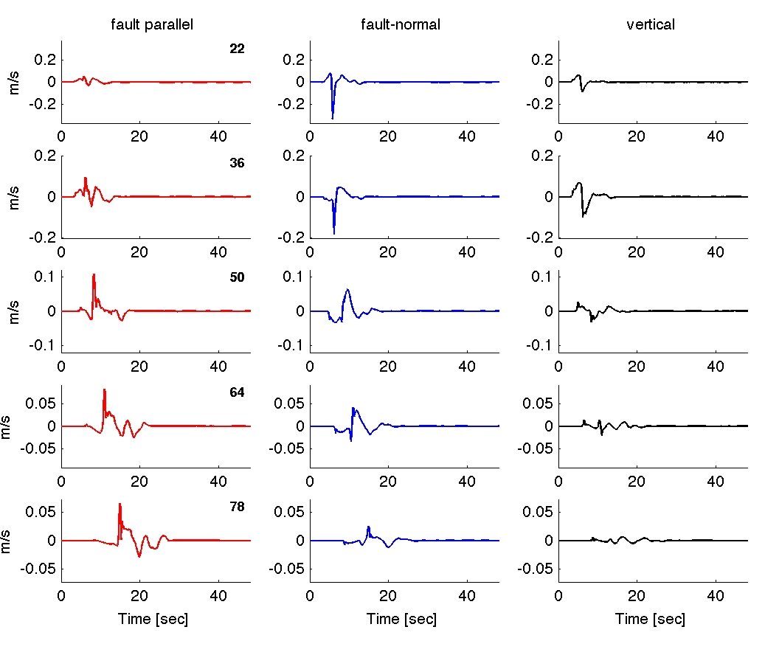
An initial inverse exercise, inv1
5 sites from a fault-perpendicular array

Slide 8
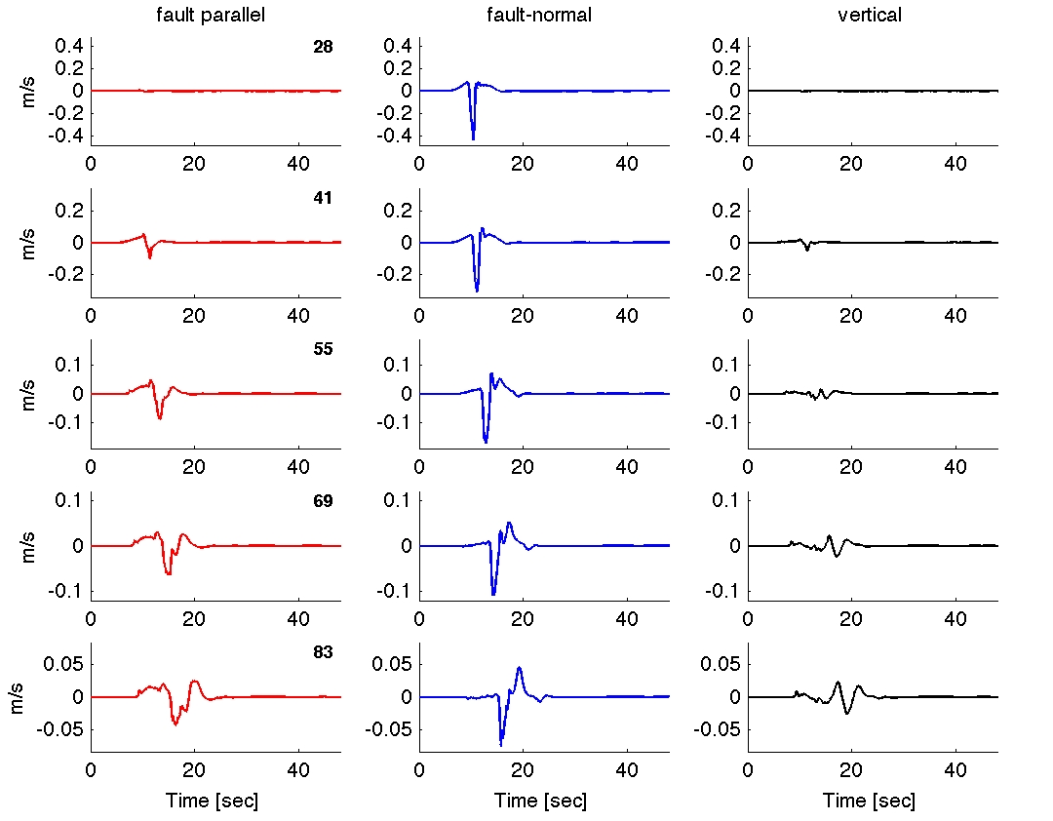
An initial inverse exercise, inv1
5 sites from an array, extending at ~30 deg from one fault edge

Slide 9
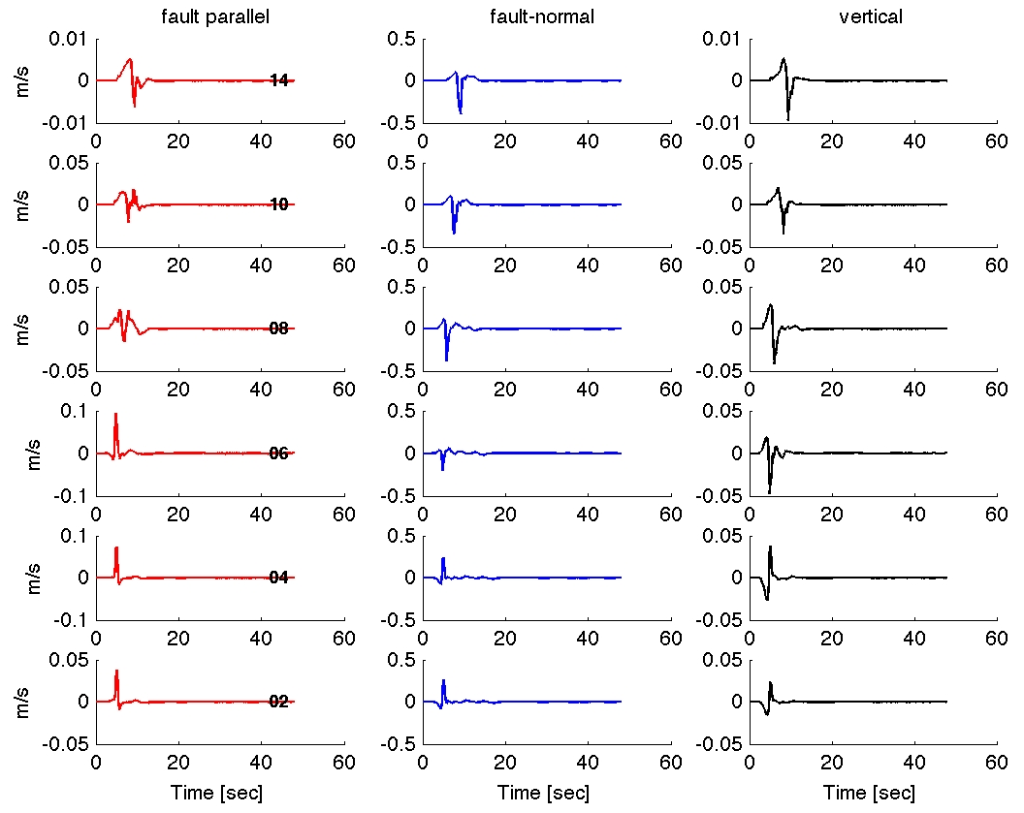
An initial inverse exercise, inv1
6 sites from a very near-fault array, parallel to the fault

Slide 10
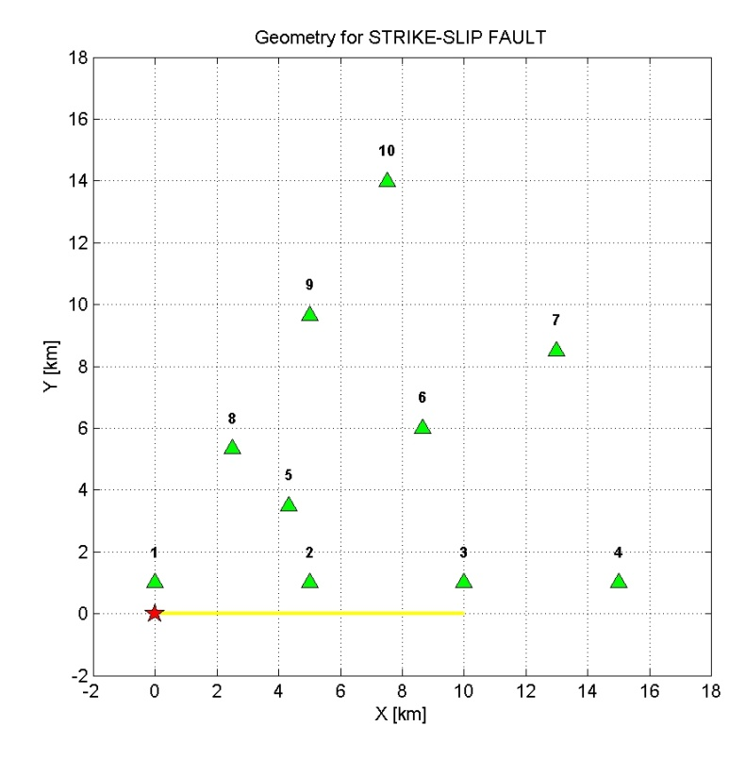
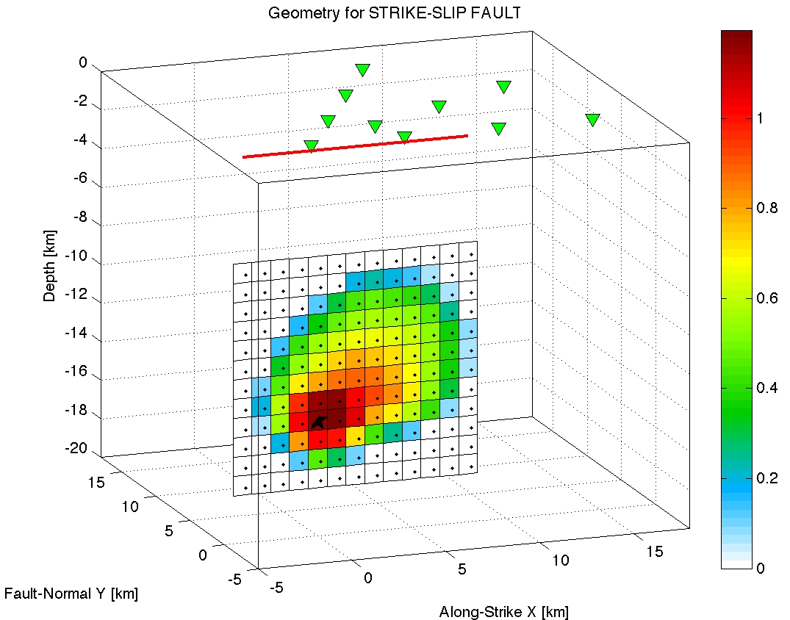
Initial results from extended-fault forward model
So far only two groups reported results
without quantification: the waveforms are quite different
Strike-slip case

Slide 11
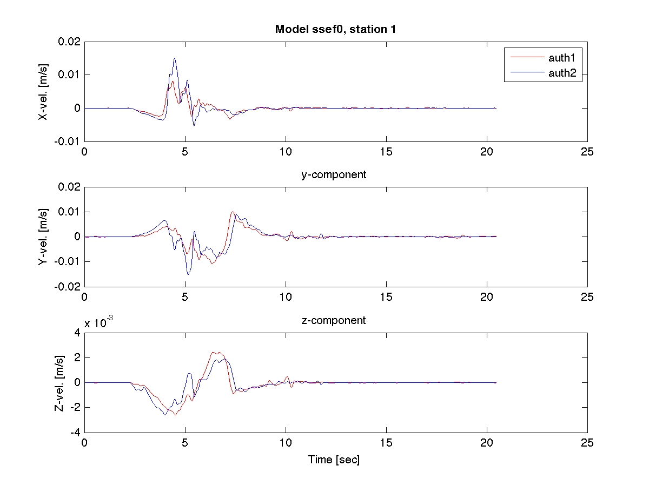
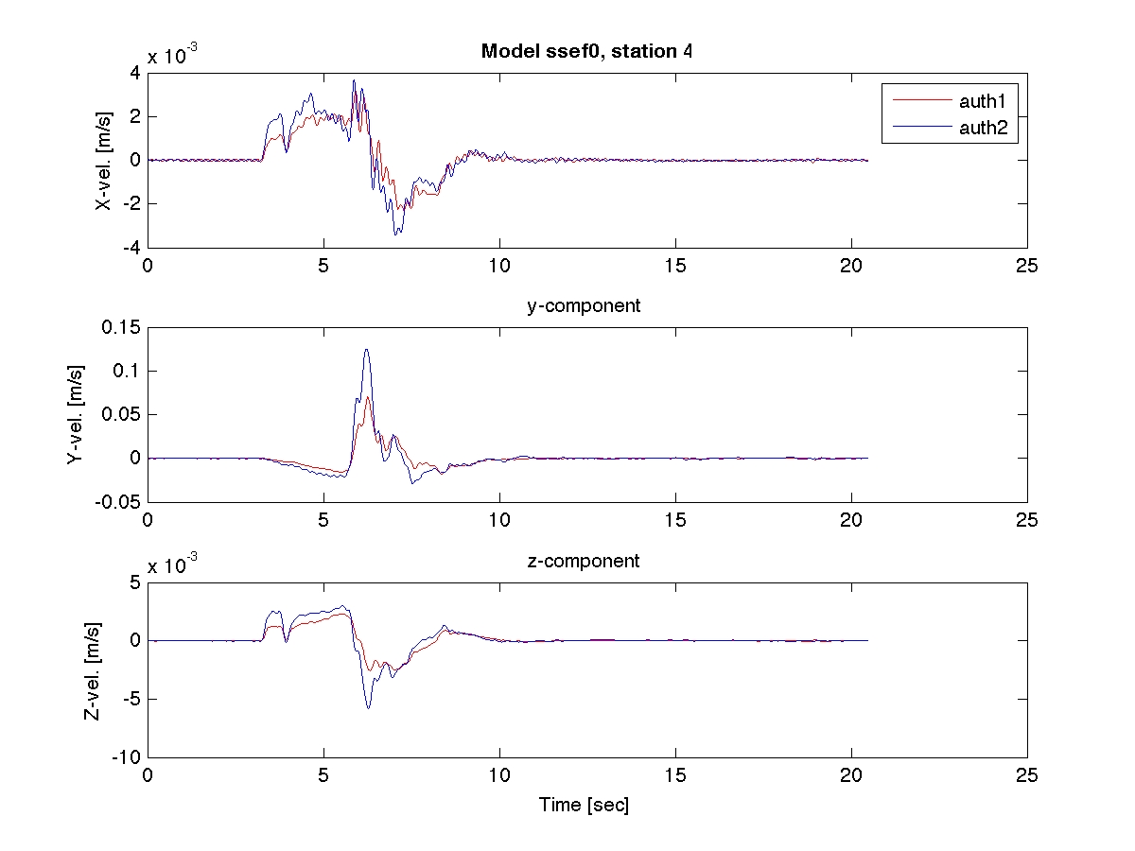
Initial results from extended-fault forward model
Strike-slip case

Slide 12
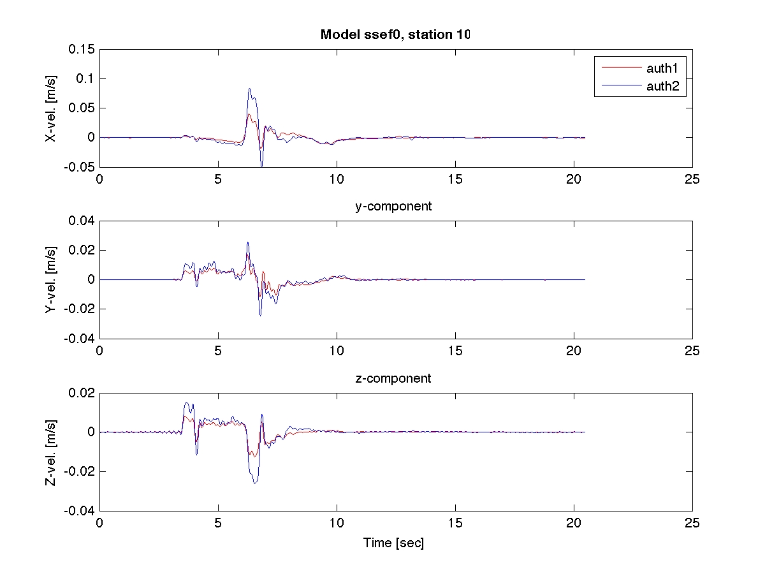
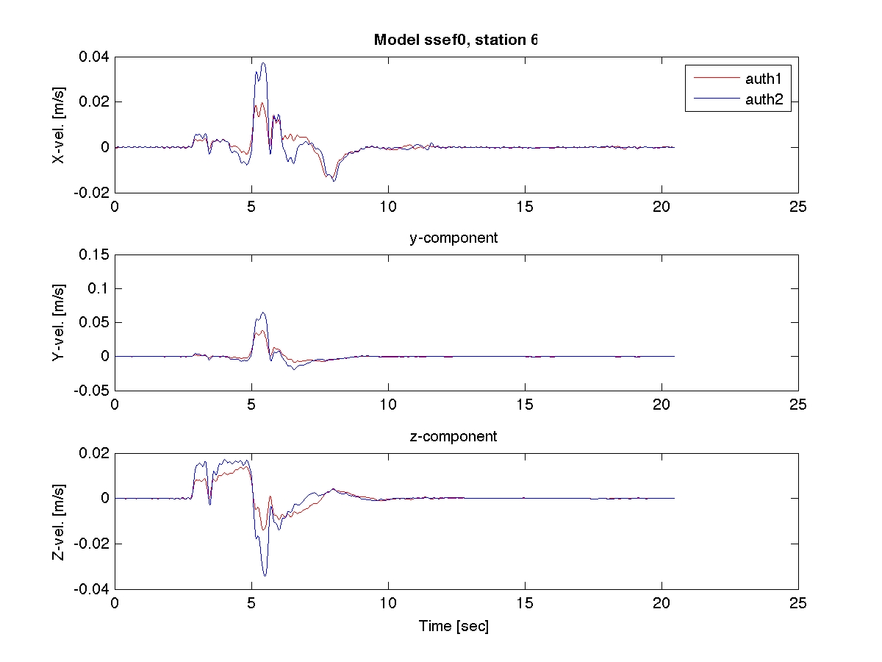
Initial results from extended-fault forward model
  amplitude mismatch
  frequency content not identical
  overall waveform character quite different

Slide 13
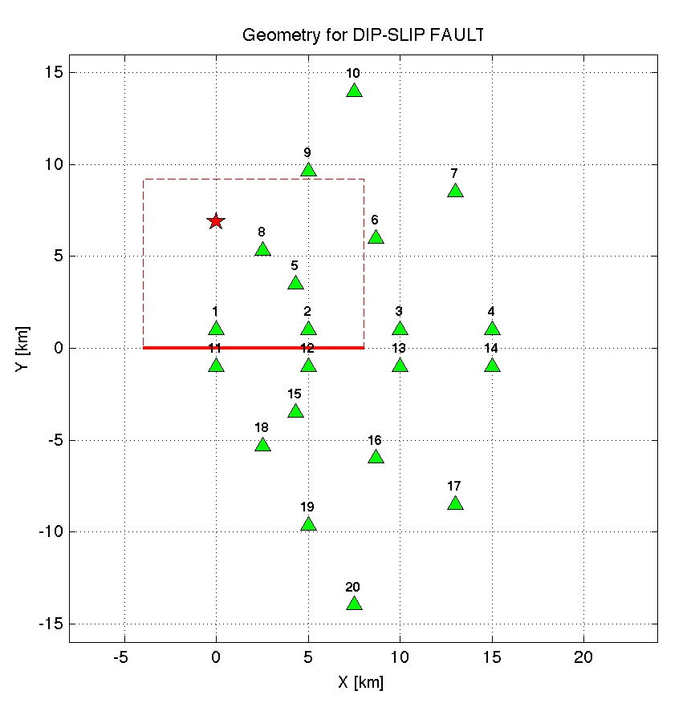
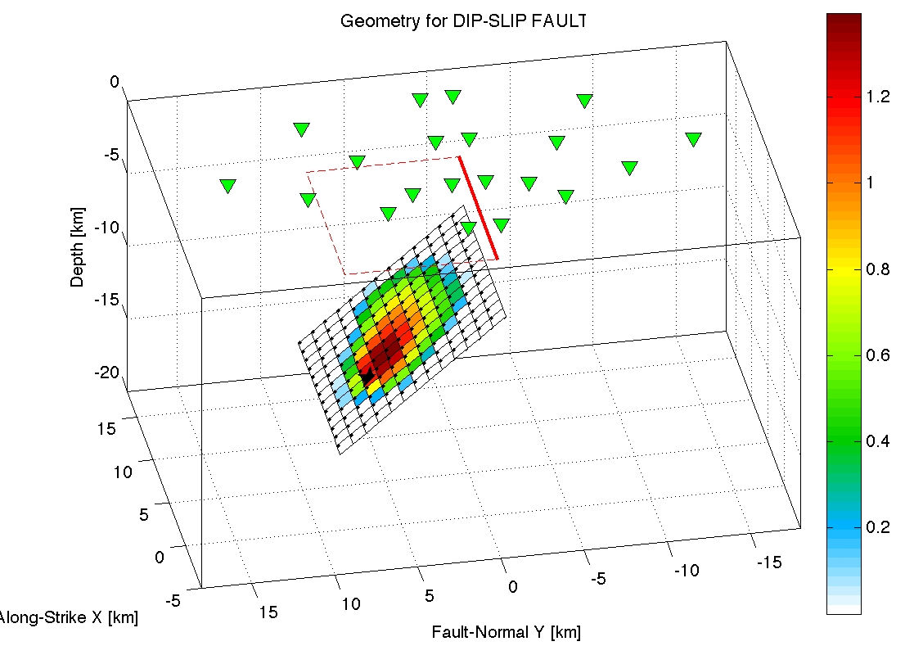
Initial results from extended-fault forward model
So far only two groups reported results
without quantification: the waveforms are quite different
dip-slip case

Slide 14
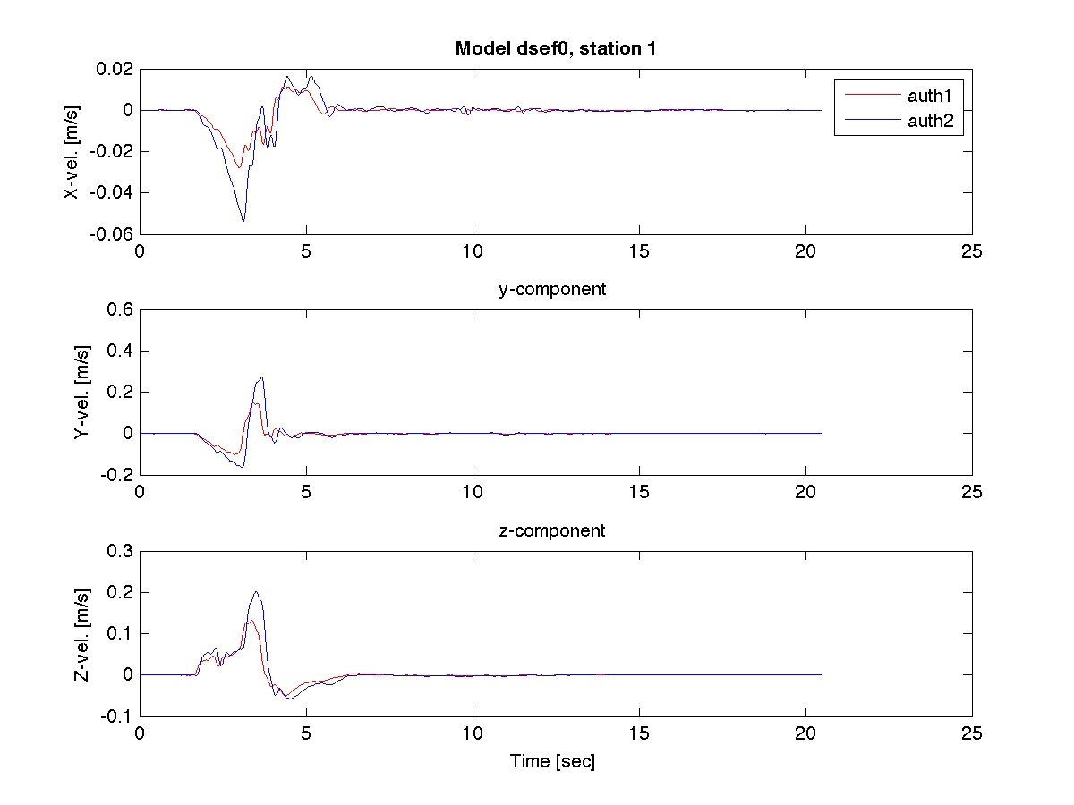
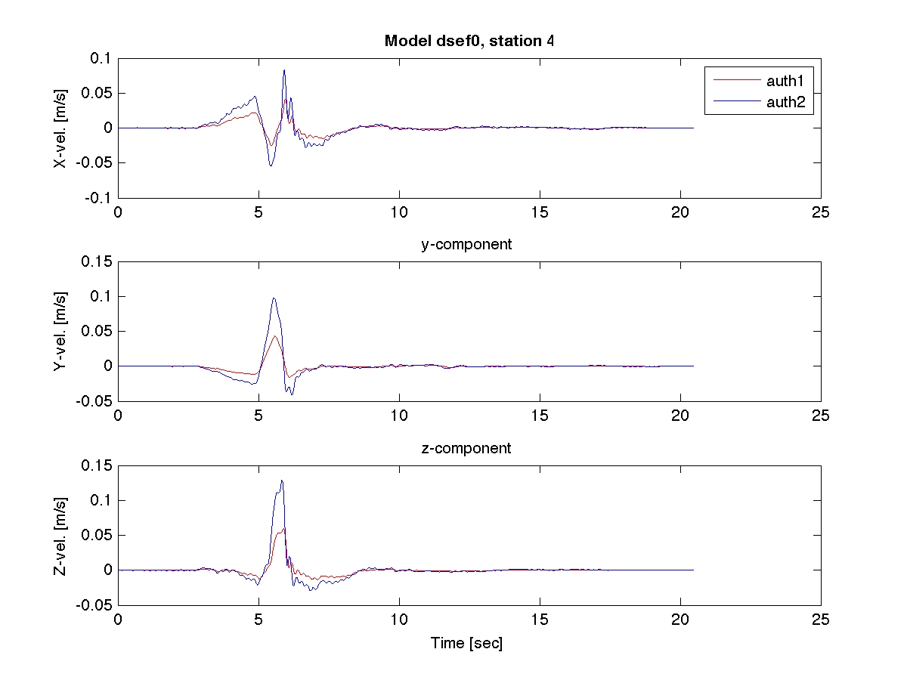
Initial results from extended-fault forward model
dip-slip case, foot-wall

Slide 15
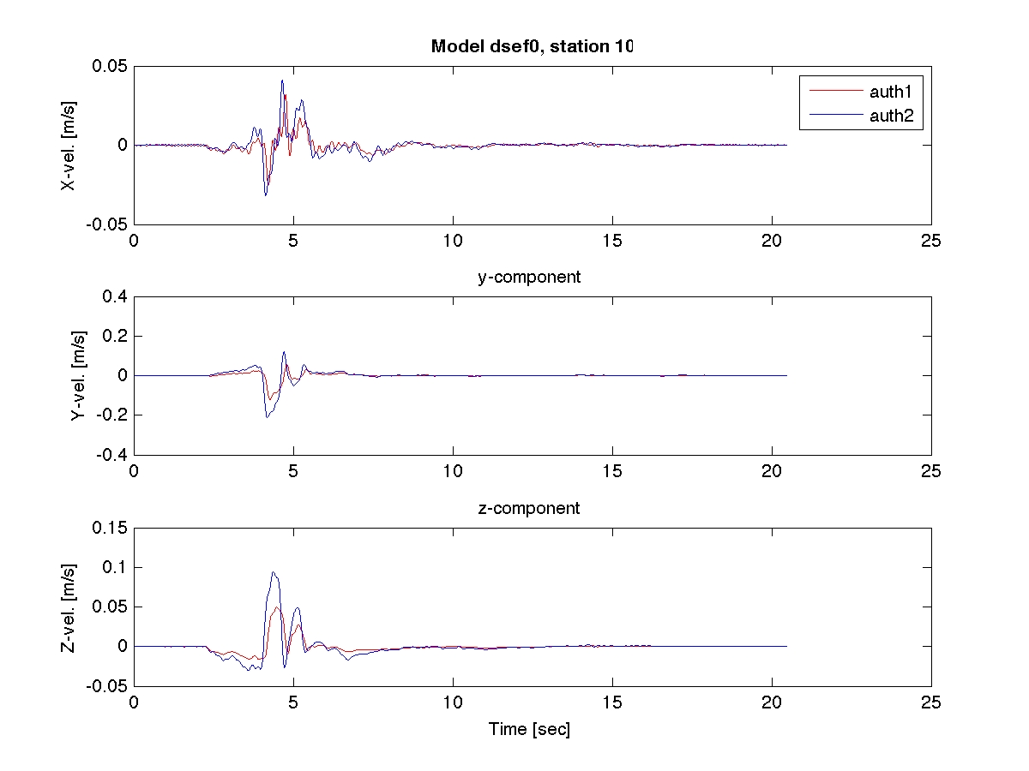
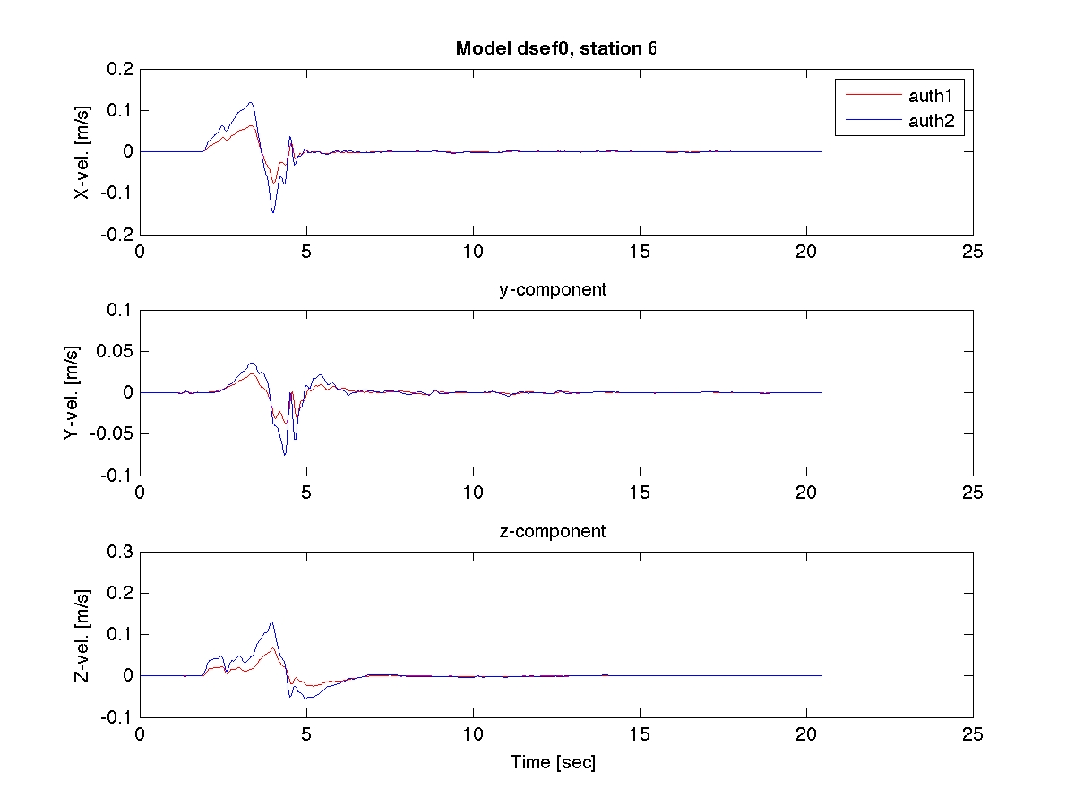
Initial results from extended-fault forward model
dip-slip case, foot-wall

Slide 16
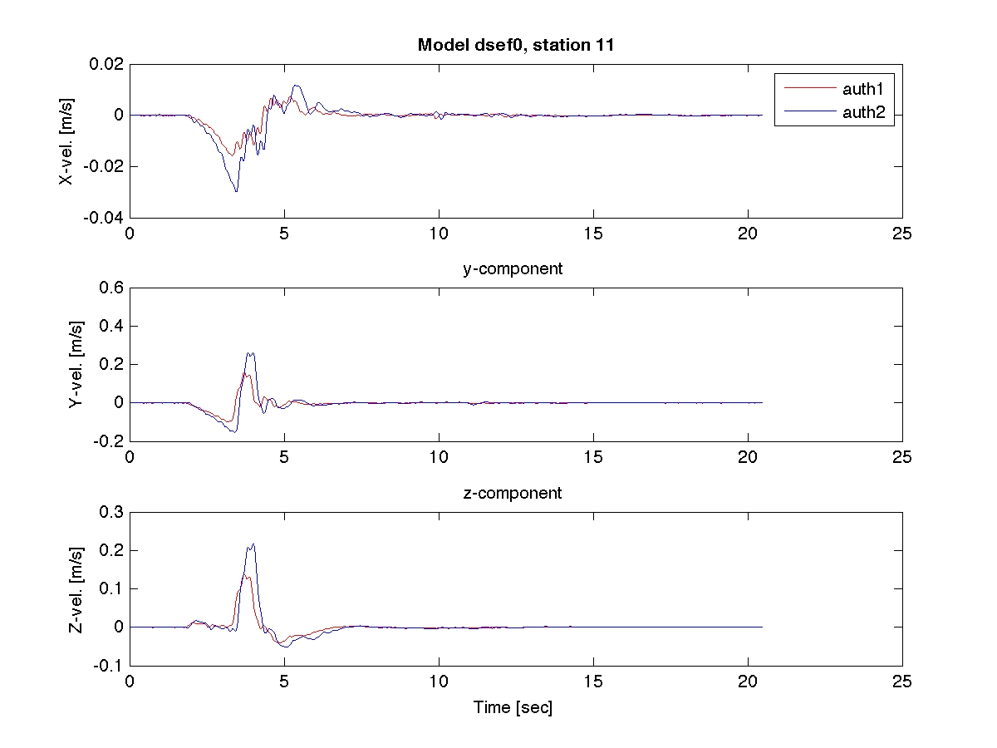
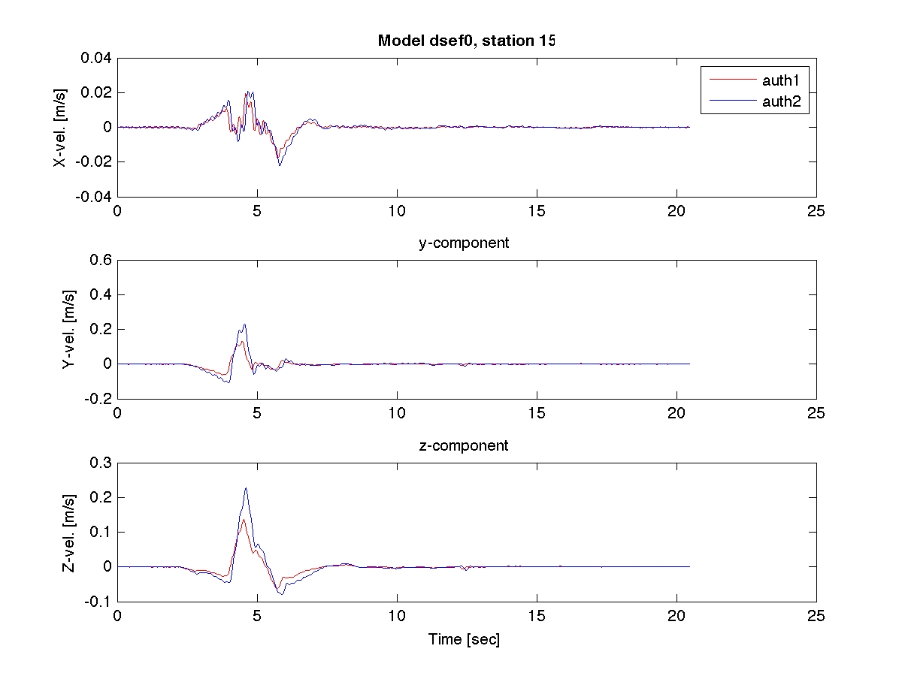
Initial results from extended-fault forward model
amplitude mismatch
frequency content more similar?
waveform character more similar?

